Slide 1

External Format Processing
Parsing JSON, JSON.NET
SoftUni Team
Technical Trainers
Software University
https://about.softuni.bg/

Slide 2
Table of Contents
JSON Data Format
Processing JSON
System.Text.Json
JSON.NET
Configuring JSON.NET
LINQ-to-JSON
XML-to-JSON
2

Slide 3
Have a Question?
sli.do
#csharp-db

Slide 4
JSON Data Format
{JSON}
Definition and Syntax

Slide 5
JSON Data Format
JSON (JavaScript Object Notation) is a lightweight data format
Human and machine-readable plain text
Based on JavaScript objects
Independent of development platforms and languages
JSON data consists of
Values (strings, numbers, etc.)
Key-value pairs: { key : value }
Arrays: [value1, value2, …]
{
"firstName": "Pesho",
"courses": ["C#", "JS", "ASP.NET"]
"age": 23,
"hasDriverLicense": true,
"date": "2012-04-23T18:25:43.511Z",
// ...
}

Slide 6
JSON Data Format (2)
The JSON data format follows the rules of object creation in JS
Strings, numbers and Booleans are valid JSON
Arrays are valid JSON
Objects are valid JSON (key-value pairs)
"this is a string and is valid JSON"
3.14
true
[5, "text", true]
{
"firstName": "Svetlin", "lastName": "Nakov",
"jobTitle": "Technical Trainer", "age": 40
}

Slide 7
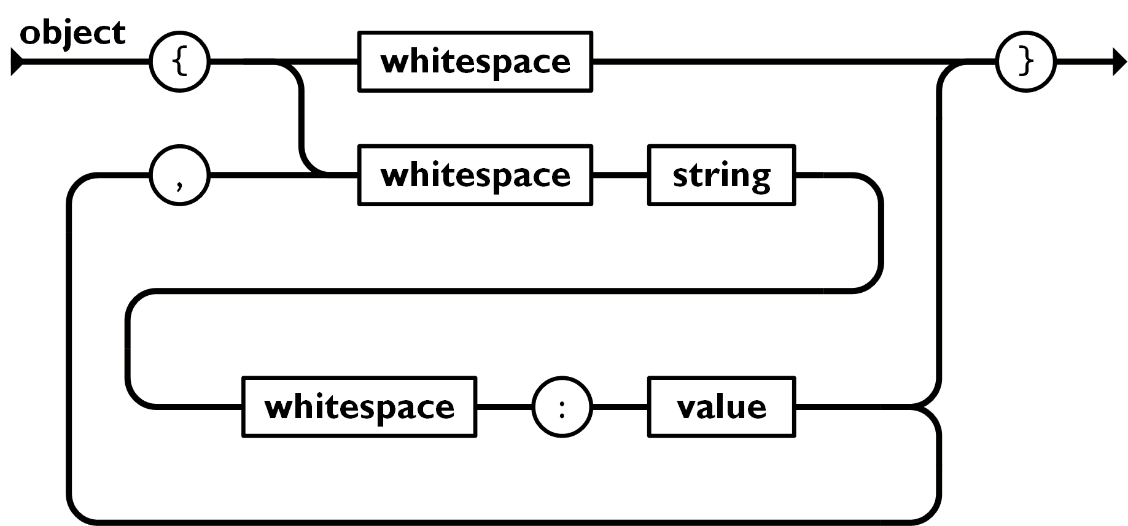
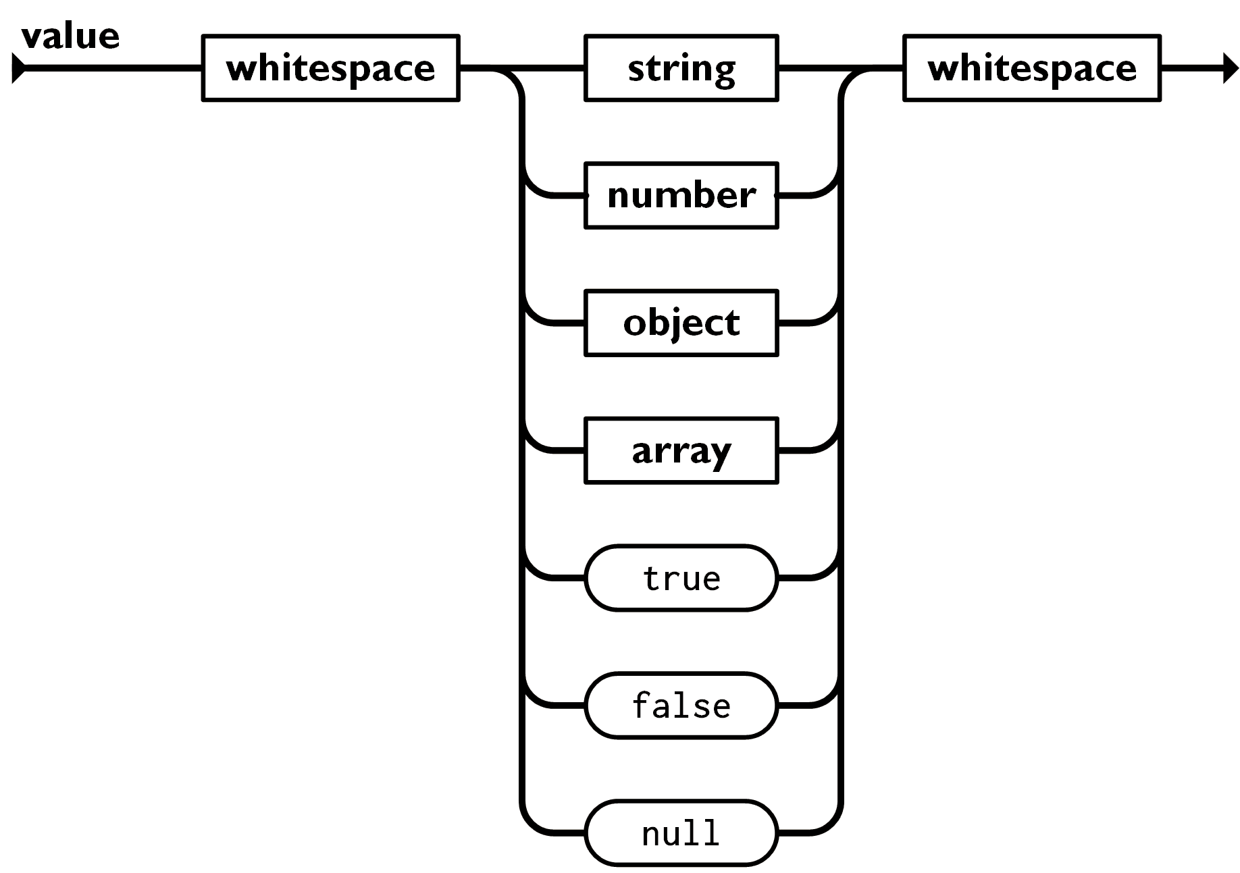

Object, Array and Value in JSON

Slide 8

Processing JSON
{JSON}
Parsing JSON in C# and .NET with System.Text.Json

Slide 9
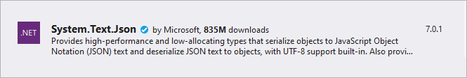
Built-in JSON Support
.NET has built-in JSON support through the System.Text.Json NuGet Package
It supports serializing objects and deserializing (parsing) strings
Include the following namespaces into your project
using System.Text.Json;
using System.Text.Json.Serialization;
9

Slide 10
Serializing JSON
The System.Text.Json serializer can read and write JSON
class WeatherForecast
{
public DateTime Date { get; set; } = DateTime.Now;
public int TemperatureC { get; set; } = 30;
public string Summary { get; set; } = "Hot summer day";
}
static void Main()
{
WeatherForecast forecast = new WeatherForecast();
string weatherInfo = JsonSerializer.Serialize(forecast);
Console.WriteLine(weatherInfo);
}

Slide 11
Serializing JSON (2)
Creating a JSON file
static void Main()
{
WeatherForecast forecast = new WeatherForecast();
string weatherInfo = JsonSerializer.Serialize(forecast);
File.WriteAllText(file, weatherInfo);
}
{"Date":"2020-07-16T13:33:25","TemperatureC":30,"Summary":"Hot summer day"}

Slide 12

Deserializing JSON
To deserialize from a file, we read the file into a string and then use the Deserialize method
static void Main()
{
string jsonString = File.ReadAllText(file);
WeatherForecast forecast = JsonSerializer.Deserialize<WeatherForecast>(jsonString);
}

Slide 13
JSON.NET
Newtonsoft
Json.NET
Better JSON Parsing for .NET Developers

Slide 14
What is JSON.NET?
JSON.NET is a JSON framework for .NET
More functionality than built-in functionality
Supports LINQ-to-JSON
Out-of-the-box support for parsing between JSON and XML
Open-source project: http://www.newtonsoft.com
Newtonsoft.Json vs System.Text.Json
Performance comparison
Table of differences

Slide 15

Installing JSON.NET
To install JSON.NET use the NuGet Package Manager
Or with a command in the Package Manager Console
Install-Package Newtonsoft.Json

Slide 16
General Usage
JSON.NET exposes a static service JsonConvert
Used for parsing and configuration to
Serialize an object
Deserialize an object
var jsonProduct = JsonConvert.SerializeObject(product);
var objProduct =
JsonConvert.DeserializeObject<Product>(jsonProduct);

Slide 17
JSON.NET Features
JSON.NET can be configured to
Indent the output JSON string
Convert JSON to anonymous types
Control the casing and properties to parse
Skip errors
JSON.NET also supports
LINQ-to-JSON
Direct parsing between XML and JSON

Slide 18
Configuring JSON.NET (1)
By default, the result is a single line of text
To indent the output string use Formatting.Indented
JsonConvert.SerializeObject(products, Formatting.Indented);
{
"pump": {
"Id": 0,
"Name": "Oil Pump",
"Description": null,
"Cost": 25.0
},
"filter": {
"Id": 0,
"Name": "Oil Filter",
"Description": null,
"Cost": 15.0
}
}

Slide 19
Configuring JSON.NET (2)
Deserializing to anonymous types
Incoming JSON
var json = @"{ 'firstName': 'Svetlin',
'lastName': 'Nakov',
'jobTitle': 'Technical Trainer' }";
var template = new
{
FirstName = string.Empty,
LastName = string.Empty,
JobTitle = string.Empty
};
var person = JsonConvert.DeserializeAnonymousType(json, template);
Template objects

Slide 20
JSON.NET Attributes
By default JSON.NET takes each property / field from the class and parses it
This can be controlled using attributes
public class User
{
[JsonProperty("user")]
public string Username { get; set; }
[JsonIgnore]
public string Password { get; set; }
}
Parse Username to user
Skip the property

Slide 21
JSON.NET Parsing of Objects
By default JSON.NET takes each property / field from the class and parses it
This can be controlled using ContractResolver
DefaultContractResolver contractResolver =
new DefaultContractResolver()
{
NamingStrategy = new SnakeCaseNamingStrategy()
};
var serialized = JsonConvert.SerializeObject(person,
new JsonSerializerSettings()
{
ContractResolver = contractResolver,
Formatting = Formatting.Indented
});

Slide 22
LINQ-to-JSON (1)
LINQ-to-JSON works with JObjects
Create from JSON string
Reading from file
Using JObject
JObject obj = JObject.Parse(jsonProduct);
var people = JObject.Parse(File.ReadAllText(@"c:\people.json"))
foreach (JToken person in people)
{
Console.WriteLine(person["FirstName"]); // Ivan
Console.WriteLine(person["LastName"]); // Petrov
}

Slide 23
LINQ-to-JSON (2)
JObjects can be queried with LINQ
var json = JObject.Parse(@"{'products': [
{'name': 'Fruits', 'products': ['apple', 'banana']},
{'name': 'Vegetables', 'products': ['cucumber']}]}");
var products = json["products"].Select(t =>
string.Format("{0} ({1})",
t["name"],
string.Join(", ", c["products"])
));
// Fruits (apple, banana)
// Vegetables (cucumber)

Slide 24
XML-to-JSON
{
"?xml": {
"@version": "1.0",
"@standalone": "no"
},
"root": {
"person": [
{
"@id": "1",
"name": "Alan",
"url": "www.google.com"
},
{
"@id": "2",
"name": "Louis",
"url": "www.yahoo.com"
}
]
}
}
string xml = @"<?xml version='1.0' standalone='no'?>
<root>
<person id='1'>
<name>Alan</name>
<url>www.google.com</url>
</person>
<person id='2'>
<name>Louis</name>
<url>www.yahoo.com</url>
</person>
</root>";
XmlDocument doc = new XmlDocument();
doc.LoadXml(xml);
string jsonText = JsonConvert.SerializeXmlNode(doc);

Slide 25

Summary
…
…
…
JSON is a cross platform text-based data format
System.Text.Json is the JSON Parser in C#
JSON.NET is a fast framework for working with JSON data

Slide 26
Questions?
Notes:
26

Slide 27














SoftUni Diamond Partners

Slide 28

Educational Partners

Slide 29
Trainings @ Software University (SoftUni)
Software University – High-Quality Education, Profession and Job for Software Developers
softuni.bg, about.softuni.bg
Software University Foundation
softuni.foundation
Software University @ Facebook
facebook.com/SoftwareUniversity
Software University Forums
forum.softuni.bg
29
Notes:
29

Slide 30

License
This course (slides, examples, demos, exercises, homework, documents, videos and other assets) is copyrighted content
Unauthorized copy, reproduction or use is illegal
© SoftUni – https://about.softuni.bg
© Software University – https://softuni.bg
Notes:
30

